Slide 1


PC Hardware Organisation and Management System
Web technology and its applications
18cs63
ADITYA RASTOGI (1JS18CS008)
AMIT(1CS18CS015)
SECTION CSE ‘A’
FACULTY:
RENUKA RAJENDRA B.

Slide 2
ABSTRACT :
This project is a catalog of PC components and related details with additional features. It provides an easy way to get the complete details of the PC Components and its related information at a single click
INTRODUCTION :
The main purpose is to offer the functionalities like Insertion and deletion in the database, that can be done only by the admin, regular users cannot make any changes in the database and to check the compatibility between components and check value for money.

Slide 3
CONTENTS:
INTRODUCTION
INTRODUCTION TO DBMS
SQL
PROJECT DESCRIPTION
REQUIREMENT SPECIFICATION
SYSTEM REQUIRMENTS
HARDWARE REQUIREMENTS
SYSTEM ANALYSIS AND DESIGN
SCHEMA DIAGRAM
ER DIAGRAM
DATA FLOW DIAGRAM
USE CASE DIAGRAM
IMPLEMENTATION
DESCRIPTION OF TABLE
TRIGGERS AND STORED PROCEDURE
TESTING
CONCLUSION
FUTURE ENHANCEMENT
SNAPSHOTS

Slide 4

Introduction to DBMS:
DBMS stands for Database Management System. We can break it like this DBMS = Database + Management System. Database is a collection of data and Management System is a set of programs to store and retrieve those data.
Storage: According to the principles of database systems, the data is stored in such a way that it acquires lot less space as the redundant data (duplicate data) has been removed before storage. Let’s take a layman example to understand this: In a banking system, suppose a customer is having two accounts, one is saving account and another is salary account.
Fast Retrieval of data: Along with storing the data in an optimized and systematic manner, it is also important that we retrieve the data quickly when needed. Database systems ensure that the data is retrieved as quickly as possible.

Slide 5
About SQL:
SQL (Structured Query Language) is a standardized programming language used for managing relational databases and performing various operations on the data in them. Initially created in the 1970s, SQL is regularly used by database administrators, as well as by developers writing data integration scripts and data analysts looking to set up and run analytical queries.
The uses of SQL include modifying database table and index structures; adding, updating and deleting rows of data; and retrieving subsets of information from within a database for transaction processing and analytics applications.

Slide 6
Project Description:
This project is basically a database of the PC components and related details. This project will provide an easy way to get details about PC Components . This project provides the complete details of the PC Components and its related information at a single click.
It also offers the functionalities like:
Insertion and deletion in the database can be done only by the admin.
Regular users cannot make any changes in the database.
Check the compatibility between components and check value for money.

Slide 7

Software requirements:
Operating System and version: Any
Front end tool: PHP, HTML and CSS.
Back end tool: MySQL.
Web Server: Apache Web Server
Programming Language: PHP, HTML and CSS.
Hardware requirements:
Processor : Any
RAM : 1 GB
Hard disk : Suitable Capacity
REQUIREMENT SPECIFICATION

Slide 8
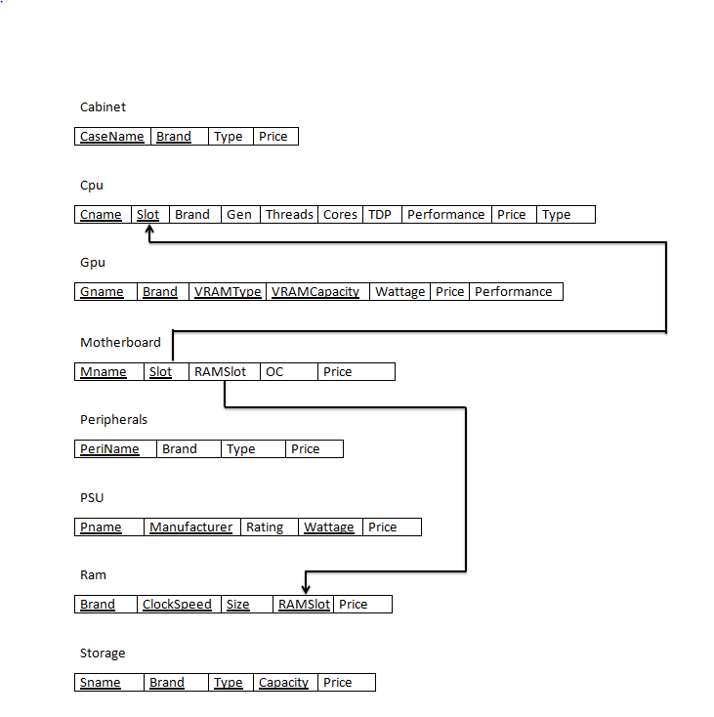
SYSTEM ANALYSIS AND DESIGN:
Schema Diagram for database

Slide 9
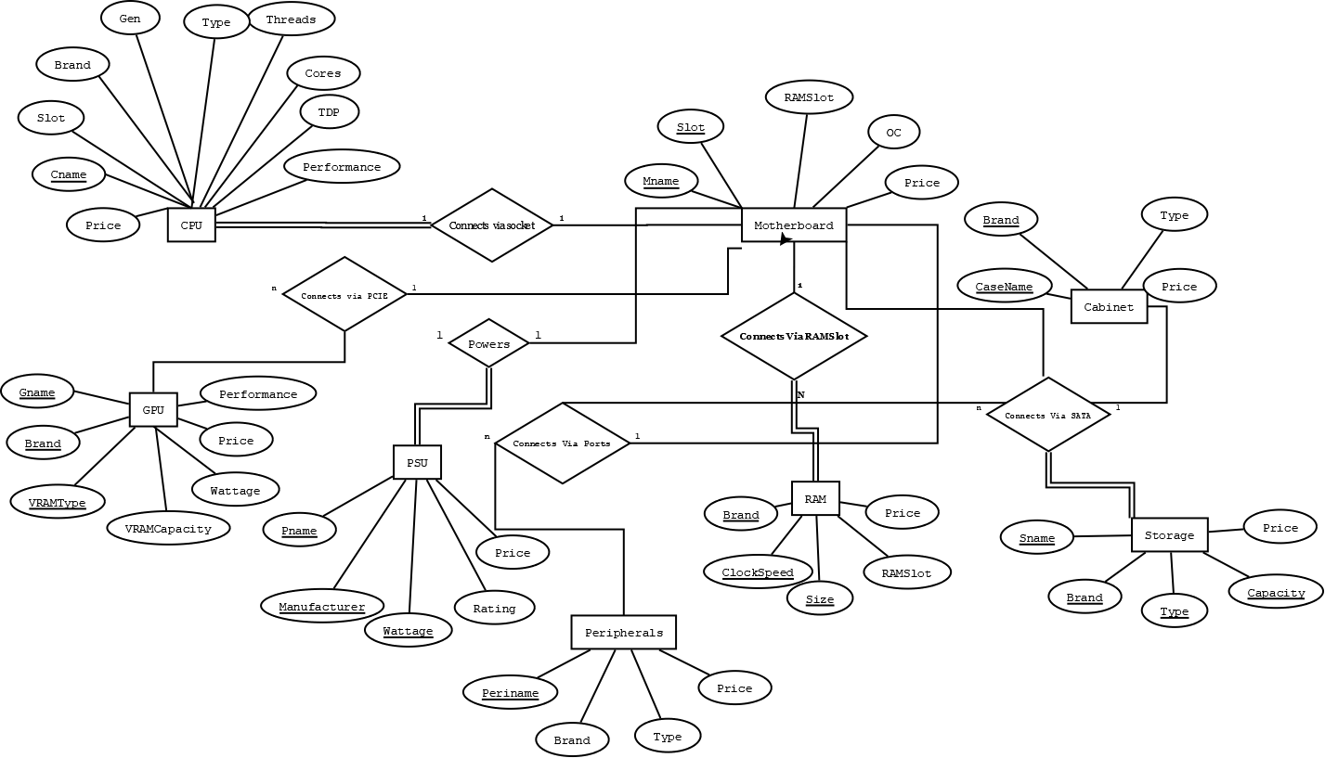
E R Diagram
ER Diagram for database

Slide 10
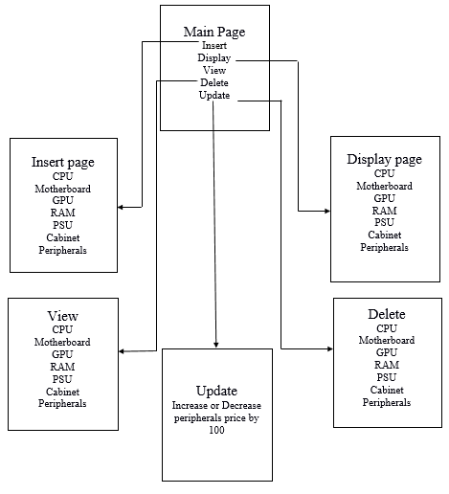
Data flow diagram
Dataflow Diagram

Slide 11
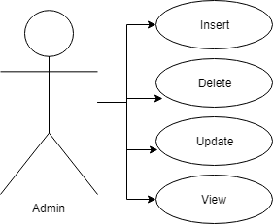
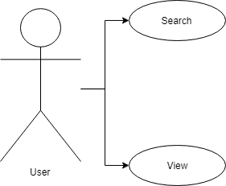
Use case diagram
Admin Use Case Diagram
User Use Case Diagram

Slide 12
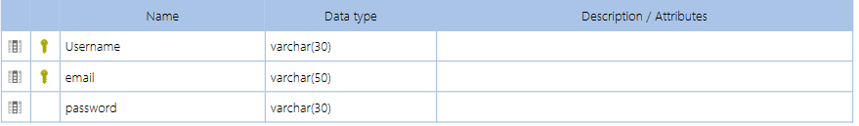
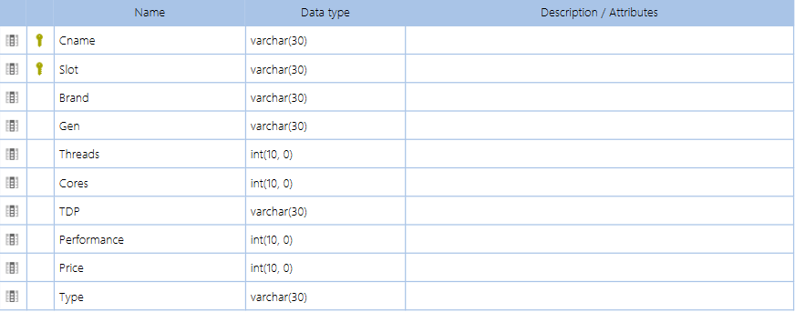
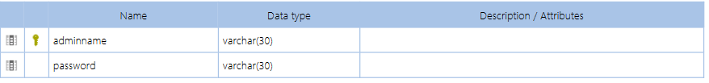
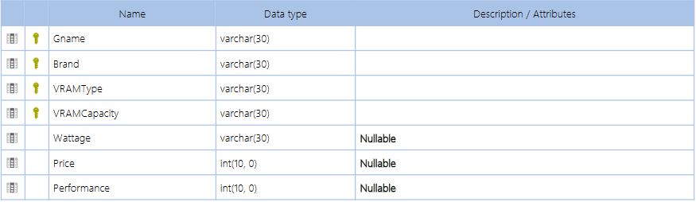
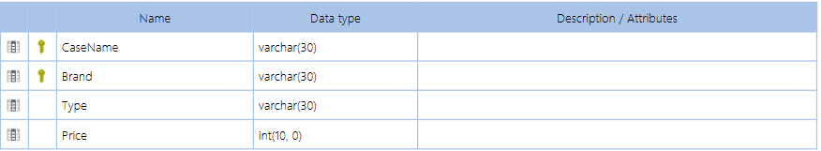
IMPLEMENTATION:
Description of tables:
registration table
Admin_Login table
CPU table
cabinet table
GPU table

Slide 13
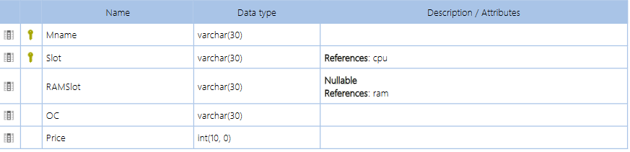
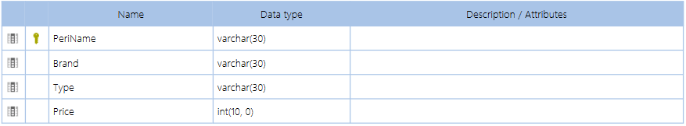
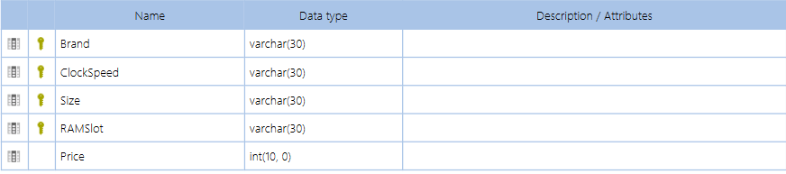
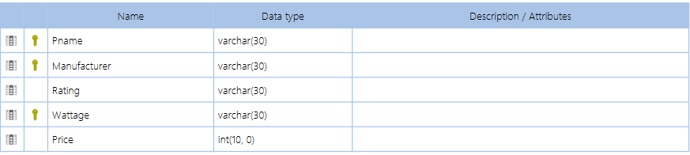
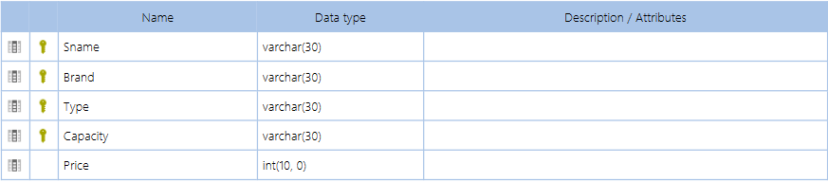
Description of tables:
motherboard table
peripherals table
RAM table
PSU table
storage table

Slide 14
Triggers and stored procedure:
Triggers: To update all lower case letters to uppercase before insertion in peripherals.
CREATE TRIGGER `Peripheral Cap` BEFORE INSERT ON `peripherals`
FOR EACH ROW set new.brand = upper(new.brand);
Stored Procedure: To increase price by 100 for peripherals and cabinet.
CREATE PROCEDURE `updateperiprice` NOT DETERMINISTIC NO SQL SQL SECURITY DEFINER UPDATE peripherals set price=peripherals.price+100;
CREATE PROCEDURE `decreaseperiprice` NOT DETERMINISTIC NO SQL SQL SECURITY DEFINER UPDATE peripherals set price=peripherals.price-100;

Slide 15
TESTING:
Conclusion:
It has been a great pleasure for us to work on this project. We hereby like to state that this application provides very good platform to everyone who wants to know about components required to assemble a PC, compatibility between parts, value for money for CPU and GPU . The admin has the privilege to edit the database i.e., insertion, deletion, updation, of pricing of peripherals etc.
Future enhancement:
To provide online purchase of the components.
Develop a common means of interaction between user and the sellers.
Provide build guides to assemble a computer.

Slide 16
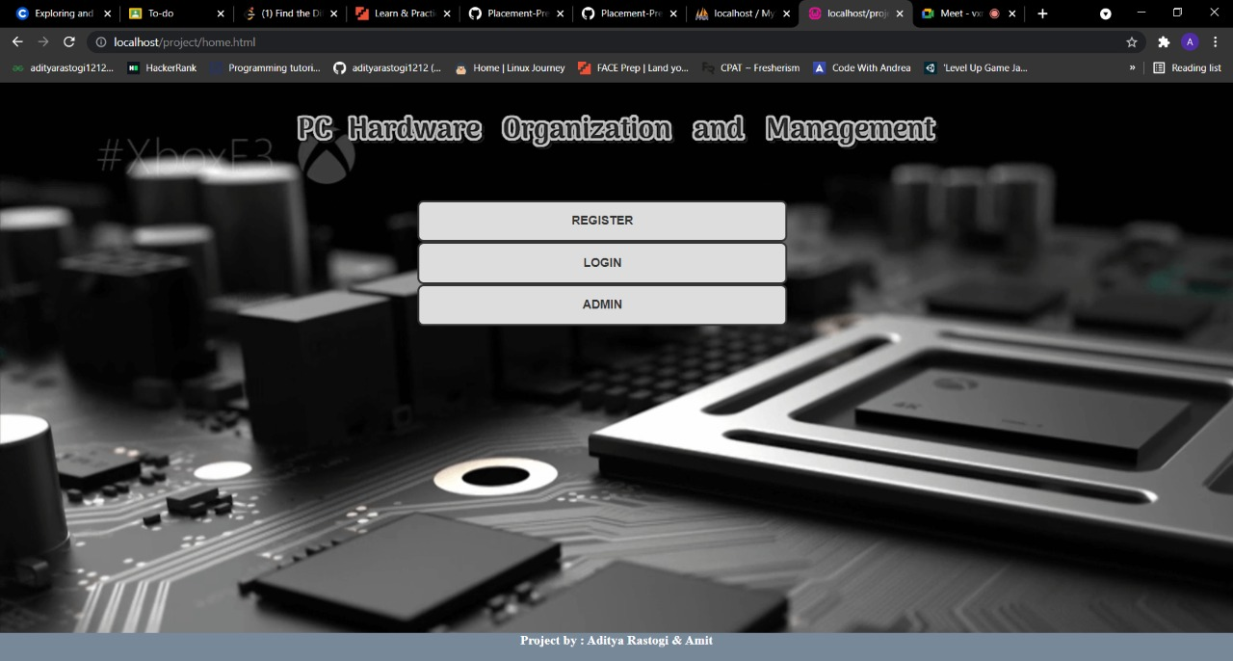

Slide 17
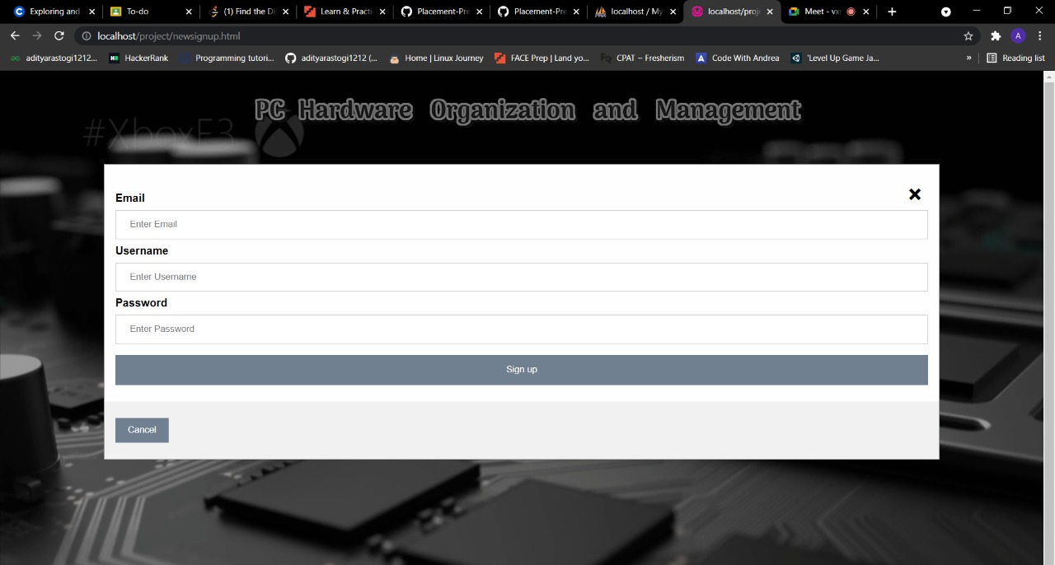

Slide 18
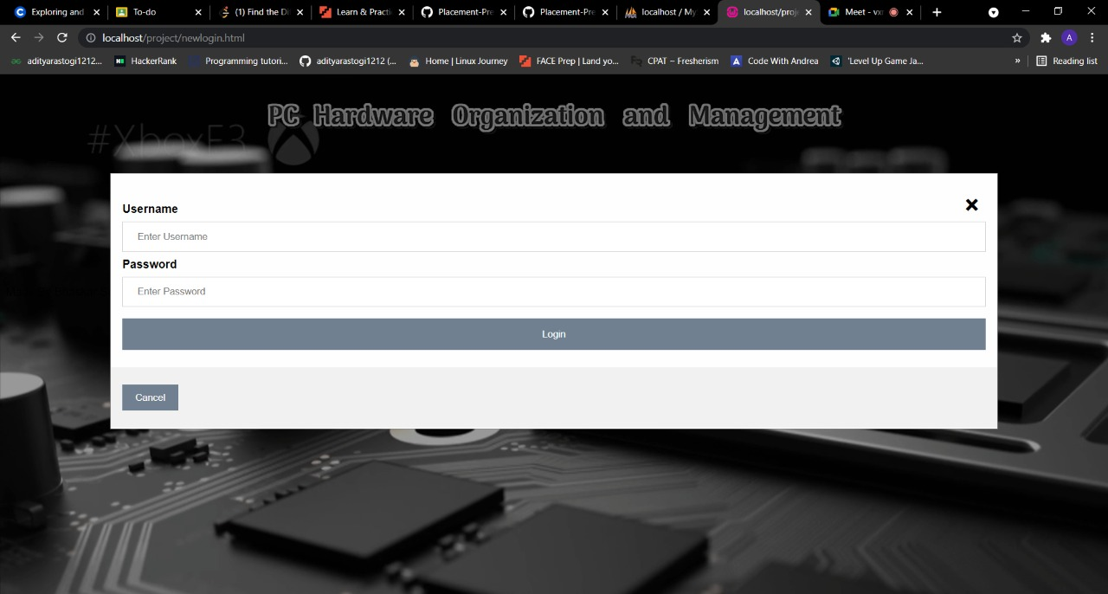

Slide 19
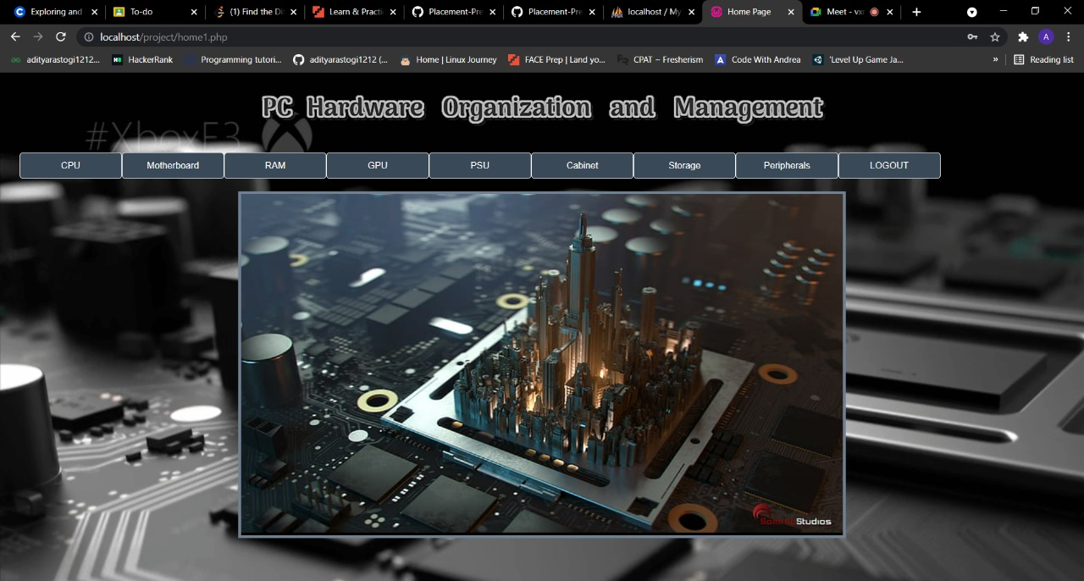

Slide 20
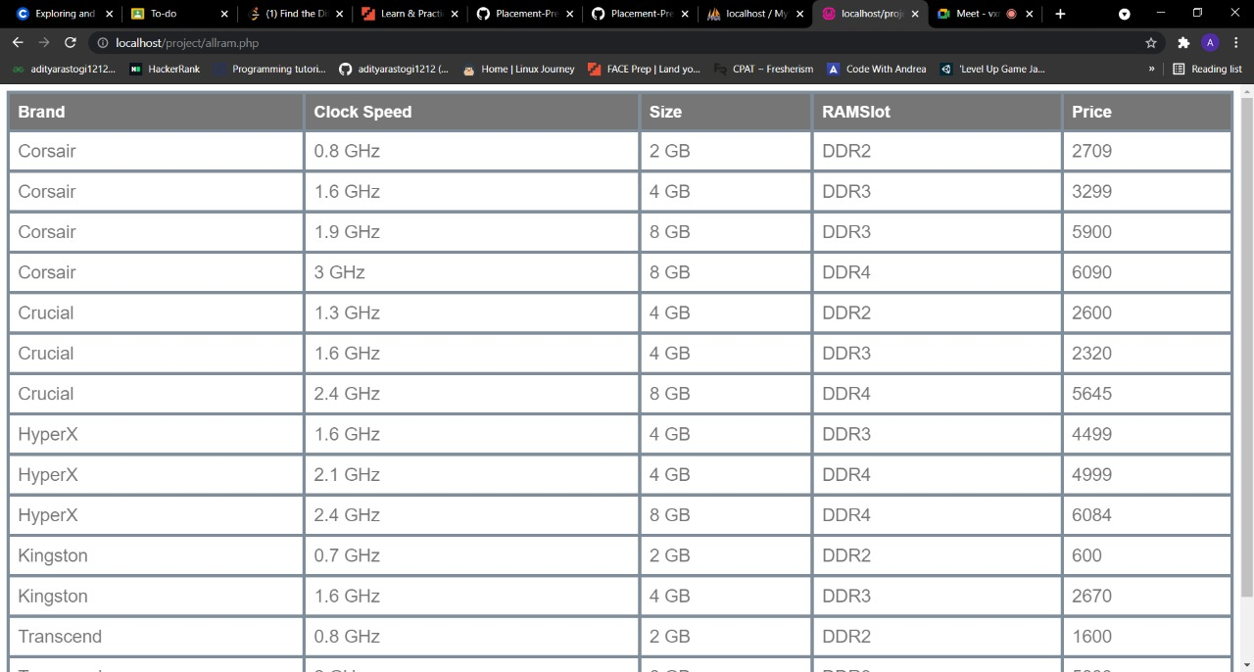

Slide 21
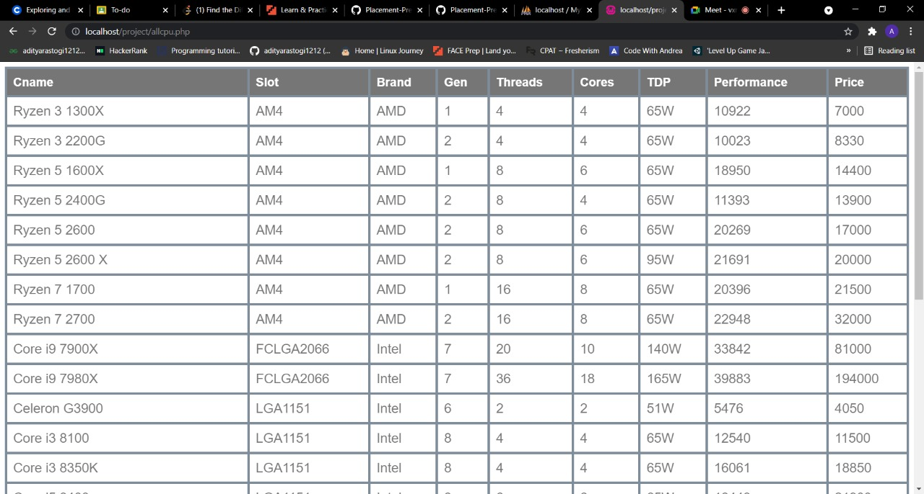

Slide 22
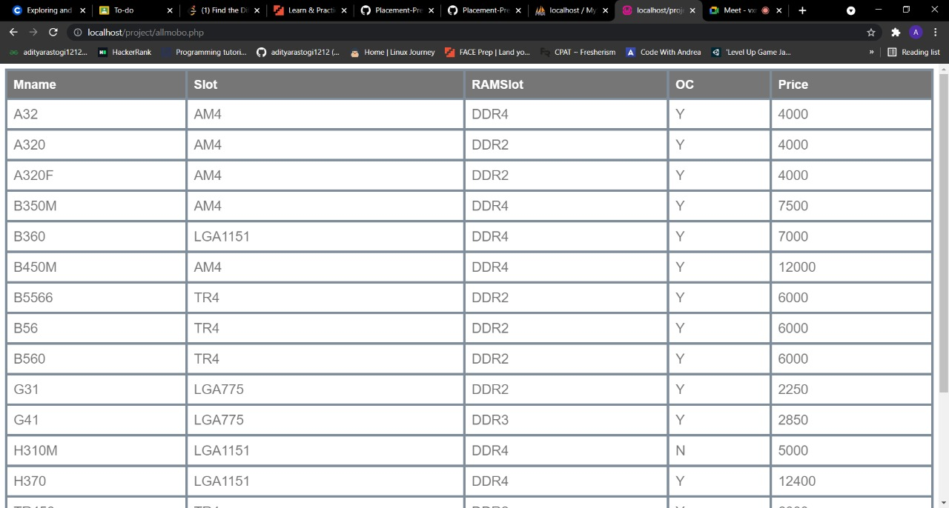

Slide 23
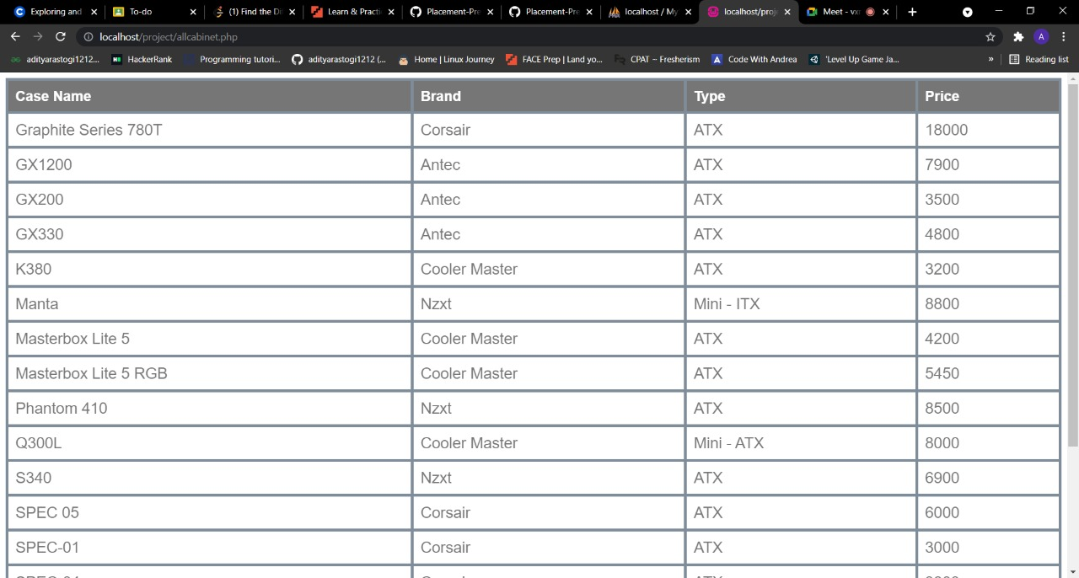

Slide 24
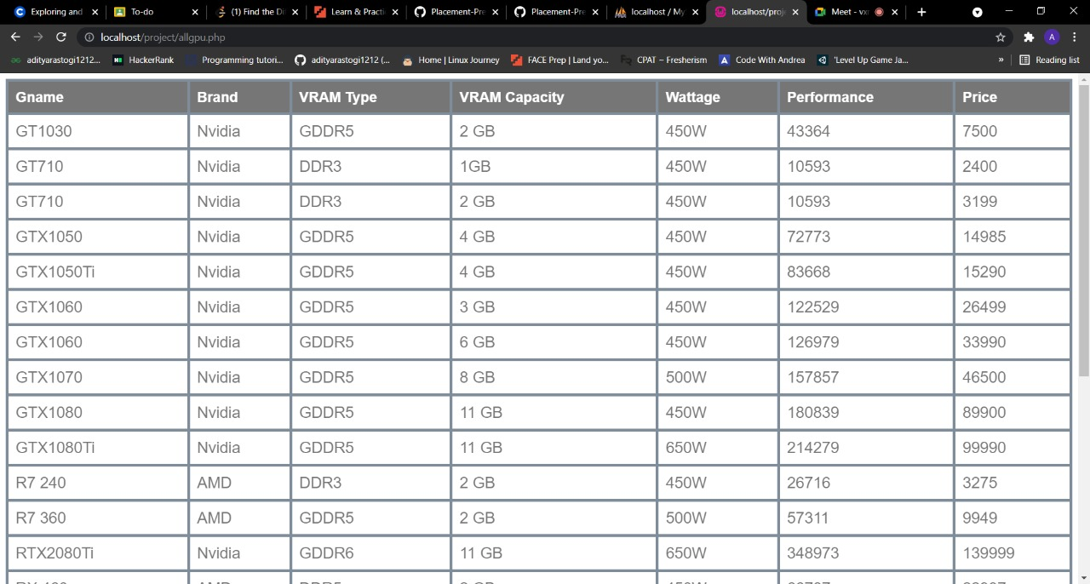

Slide 25
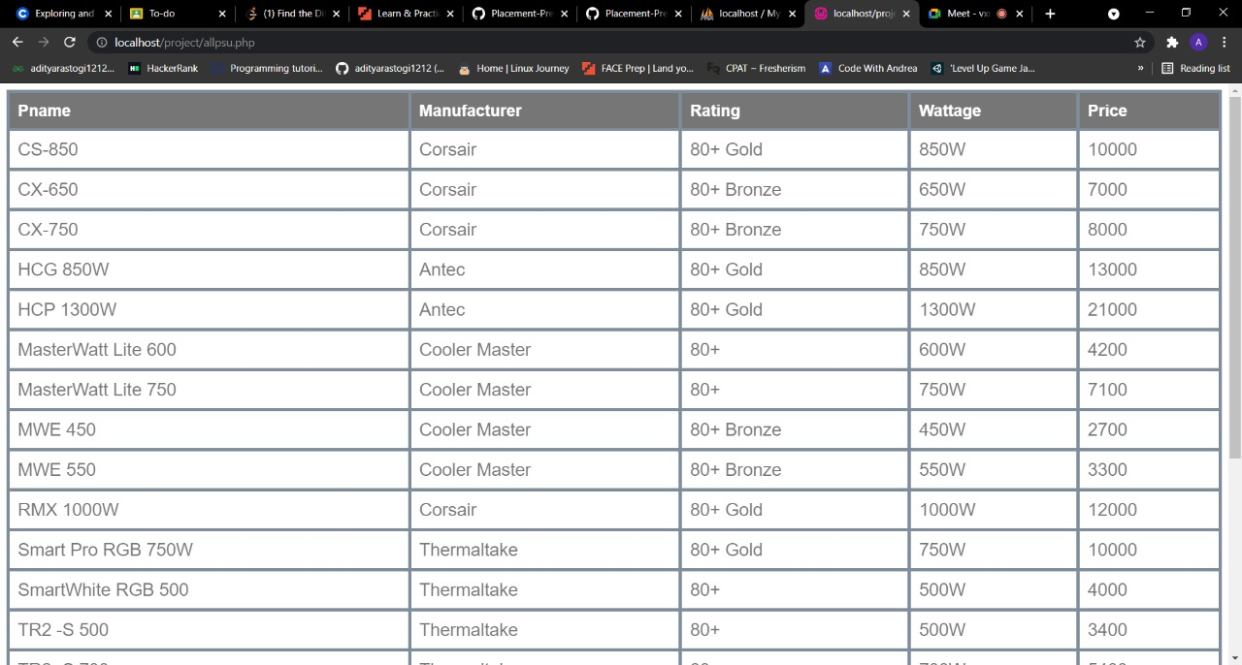

Slide 26
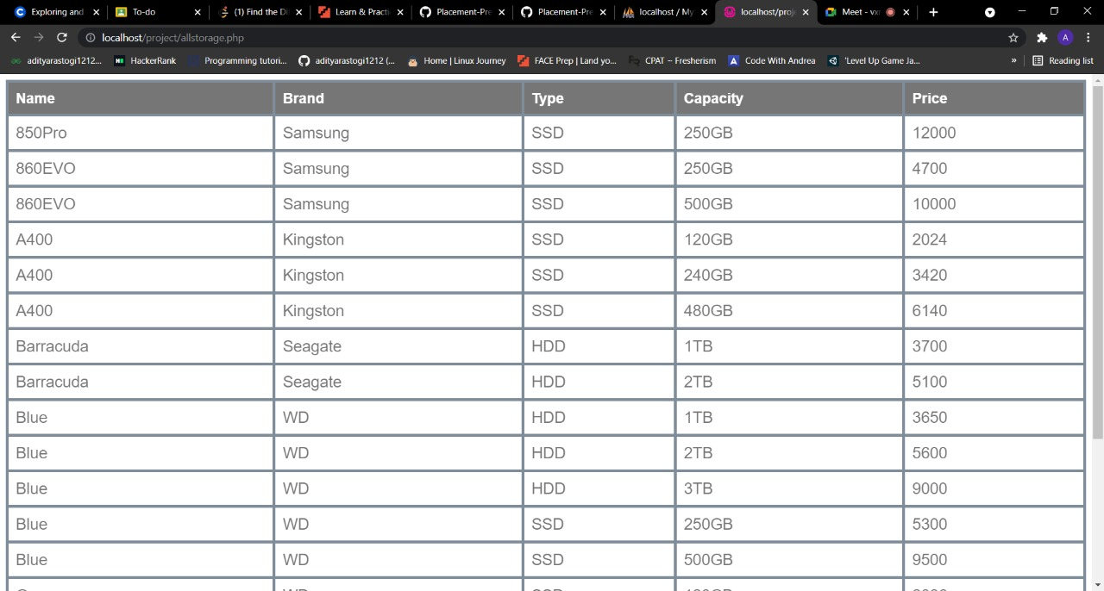

Slide 27
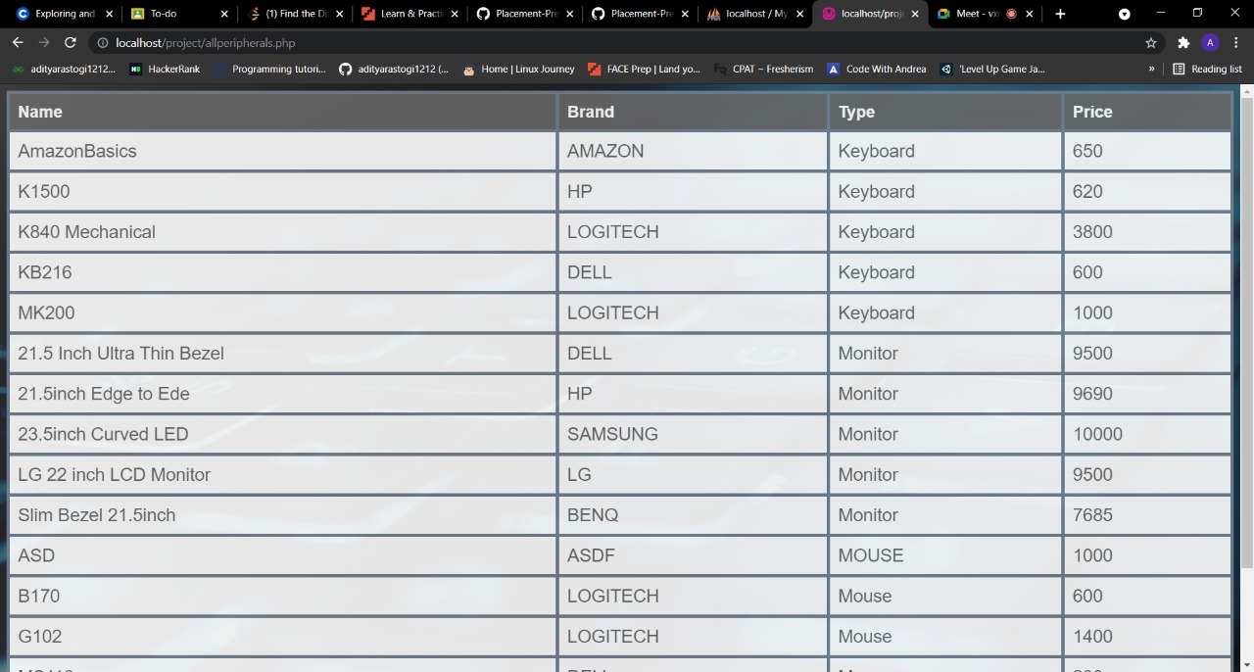

Slide 28
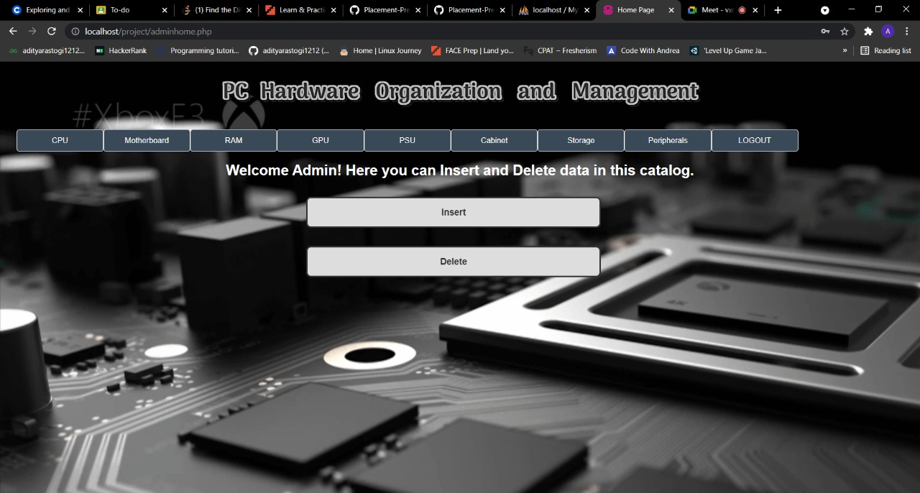

Slide 29
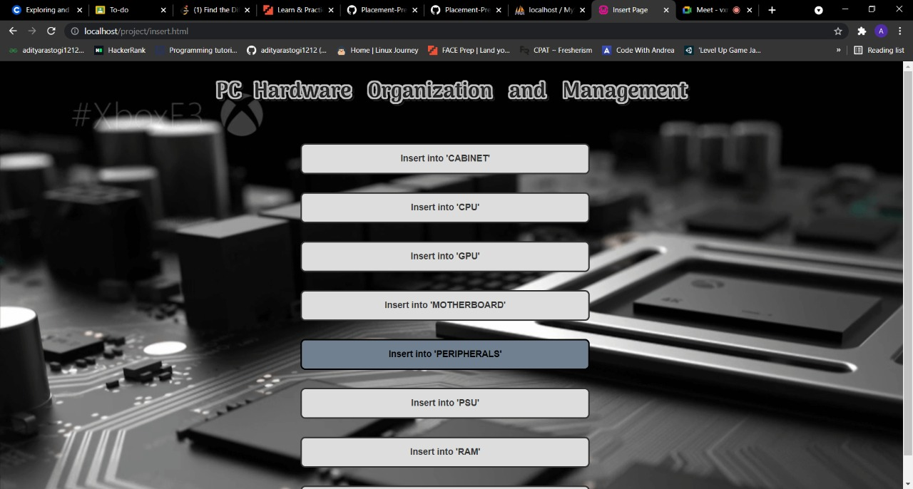

Slide 30
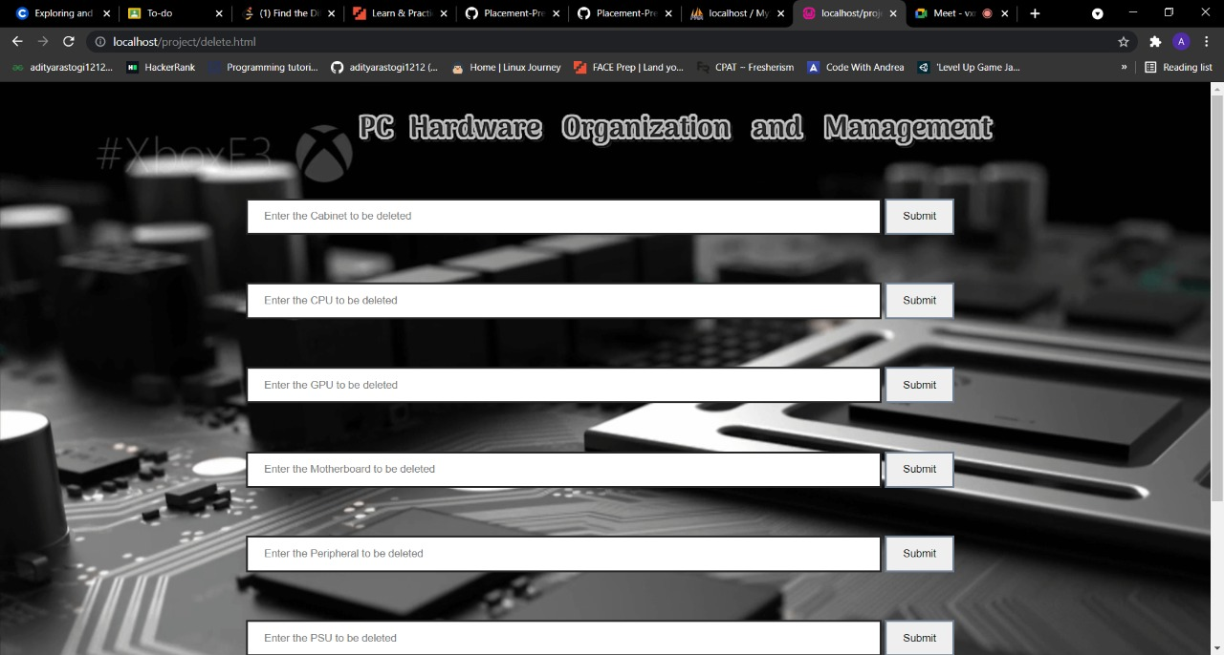

Slide 31
THANK
YOU

